Slide 1
PHP With Azure Web Apps
Brijraj Singh
Sr. Tech Evangelist (OSS)

Slide 2
How to use this template:
Type
• Use only the Microsoft brand typeface for screen-viewed media—Segoe UI and Segoe UI bold.
• The Segoe UI typeface is available for download at Media Bank.
Layout
• Format your slides using the premade “Slide Layouts” of the presentation theme in this template.
• Use the slides with colored backgrounds for presentations in dark rooms.
• Instead of typesetting every word, use the “Notes” feature to reduce the amount of copy on your slides.
Resources
• Additional templates and photo assets can be retrieved from the Media Bank (Internal to Microsoft)

Slide 3
Agenda
Why an Azure Web App ?
Deployment over Azure
Scaling Azure Web Apps
Architecture – Traffic Manager for Web apps
Case Studies
Demo – Deploy a PHP Web app from FTP, and GIT.
Questions ?

Slide 4
Hosting models
Business model
On Premises
Infrastructure
(as a Service)
Platform
(as a Service)
Software
(as a Service)
Applications
Applications
You manage
Applications
Applications
You scale, make resilient and manage
You scale, make
resilient & manage
Data
Data
Data
Data
Runtime
Runtime
Runtime
Runtime
Scale, resilience and management by vendor
Middleware
Middleware
Middleware
Scale, resilience and management by vendor
Middleware
O/S
O/S
O/S
O/S
Virtualization
Virtualization
Managed by vendor
Virtualization
Virtualization
Servers
Servers
Servers
Servers
Storage
Storage
Storage
Storage
Networking
Networking
Networking
Networking

Slide 5




Web Apps
Logic Apps
Mobile Apps
Administration App
Customer site
Order Completed
Customer App
http
SQL
API Apps

Slide 6
Why an Azure Web App ?
1
Familiar and Fast
2
Enterprise Grade Security
3
Global Scale with High Availability
4
Use Azure SDK to Interact with Azure Resources
5
Easy Continuous Deployment
Notes:
Azure App Service Web Apps is a fully managed platform that enables you to build, deploy and scale enterprise-grade web apps in seconds. Focus on your application code, and let Azure take care of the infrastructure to scale and securely run it for you. Web Apps is:
Familiar and Fast - Use your existing skills to code in your favorite language, framework, and IDE. With just a few clicks, add versioning, updating, single sign-on, identity broker, isolated storage, and performance monitoring to your existing web apps. Access a rich gallery to use as building blocks to accelerate your development. Experience unparalleled developer productivity with cutting edge capabilities like continuous integration, live-site debugging, and industry leading Visual Studio IDE.
Enterprise Grade - Web Apps is designed for building and hosting secure mission-critical applications. Build Active Directory integrated business apps that connect securely to on-premises resources, then host them on a secure cloud platform that is ISO, SOC2, and PCI compliant. All while enjoying enterprise level SLAs.
Global Scale - Web Apps is optimized to provide availability and automatic scale on a global datacenter infrastructure. Easily scale applications up or down on demand. With high availability provided within and across different geographical regions. Replicating data and hosting services in multiple locations is quick and easy, making expansion into new regions and geographies as simple as a mouse click.

Slide 7
Develop apps with…
.NET | Node.js | PHP | Python | Java
Microsoft Azure
Users
Developer

Slide 8
Continuous Integration
Microsoft Azure
Users
Developer

Slide 9
Enterprise Connectivity
Dynamics
SQL
SAP
Oracle
Microsoft Azure
Users
On-Premises
Virtual Network

Slide 10
API APP Templates
Use existing PHP/Other Languages Templates for boilerplate code
PHP Empty Web
PHP Starter Kit
Drupal
WordPress
Drupal Commerce
Magento
phpBB
Media Wiki

Slide 11
Supported PHP Versions
PHP Support
5.3.13 (Supported)
5.4.0 (Default Installed)
5.5 (update to by choice)
5.6 (update to by choice)
Opt for a custom runtime
Get a thread safe, VC9 or VC11 compatible version of php
Put your runtime in /bin folder and upload
Set the handler mapping in Azure Dashboard

Slide 12




Deployment
GIT : FTP
01010111001010101010001010100011101010100101
GIT : FTP
01010111001010101010001010100011101010100101
GIT : FTP : Web Deploy : TFS Deploy
01010111001010101010001010100011101010100101

Slide 13

Scaling

Slide 14
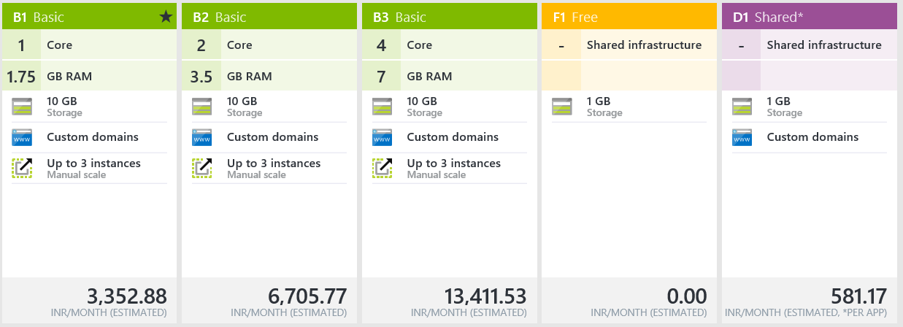
Scaling

Slide 15
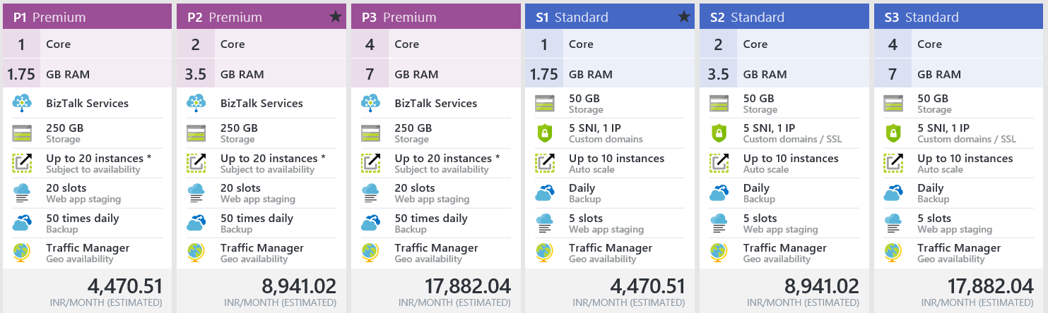
Scaling

Slide 16
Scaling
Free account
Free mode
Move to Shared
Map domain name
Traffic increase + revenue
Scale

Slide 17
Architecture
Traffic Manager

Slide 18
Request Process Flow – Inactive Site (Cold Site)
Azure
LB
1
3
Web Worker
1. Request for a foo.com arrives to ARR/Load Balancer
IIS ARR
(LB)
2. ARR gets info from Hosting DB about foo.com and determines which Web Worker (web server(s)) should host the site.
(WAWS is actively monitoring all Web Servers in the farm..
5
2
5
Hosting DB
Site’s
Content DB
5
4
3. ARR forwards request to the designated web Worker using
5
4. Web Worker provisions site
* de-provision inactive sites
Storage Controller
5. Web Worker executes request accessing site’s content and site’s DB

Slide 19
Request Process Flow – Active Site (Hot Site)
Azure
LB
1
2
Web Worker
1. Request for a foo.com arrives on ARR/Load Balancer, which already “familiar” with foo.com
IIS ARR
(LB)
3
2. ARR remembers foo.com and route the request to the right web worker(s).
3
3. Web Worker executes request accessing site’s content and site’s DB
3
Site’s
Content DB
* Subsequent requests to this site get automatically routed to fully provisioned Web Worker.
3
Storage Controller

Slide 20
Case Studies
One of the key leaders in Finance and Credit Card Optimization in India uses PHP Azure Web Apps and API Services for Continuous Integration and ease of scale.
Another upcoming Web based education service is also using PHP Azure webapps.

Slide 21
DEMO !
Deploying a Sample PHP Azure Web App Using FTP and Git.
Scaling a PHP Azure Web App

Slide 22
Q & A

Slide 23


References
https://azure.microsoft.com/en-us/services/app-service/web/
https://tryappservice.azure.com/
https://azure.microsoft.com/en-in/documentation/articles/web-sites-php-mysql-deploy-use-ftp/
http://windows.php.net/download/
https://azure.microsoft.com/en-us/documentation/articles/web-sites-php-configure/#how-to-change-the-built-in-php-version
https://github.com/Azure/azure-sdk-for-php
https://github.com/Microsoft/ApplicationInsights-PHP
technet.microsoft.com/en-in
aka.ms/mva
msdn.microsoft.com/
Developer Network

Slide 24

Tell us what you think
Help us shape future events by sharing your valuable feedback.
Scan the QR code to evaluate this session.

Slide 25

Thank you
Follow us online
Twitter: @brijrajsingh
Email: brsingh@Microsoft.com

Slide 26

Attend the last session of the day and
get a chance to
Win a Cool Device!

Slide 27

Tweet2Win Contest
Keep tweeting with #FutureUnleashed
&
Win exciting prizes at the end of the day

Slide 28
Ask the Experts
Tweet a selfie with your question written on paper with #FutureUnleashed
&
Experts answer it for you @Meet the Experts session!

Slide 29


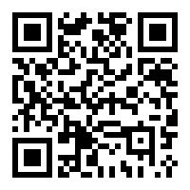



Download India Tech Community App now !!!

Slide 30
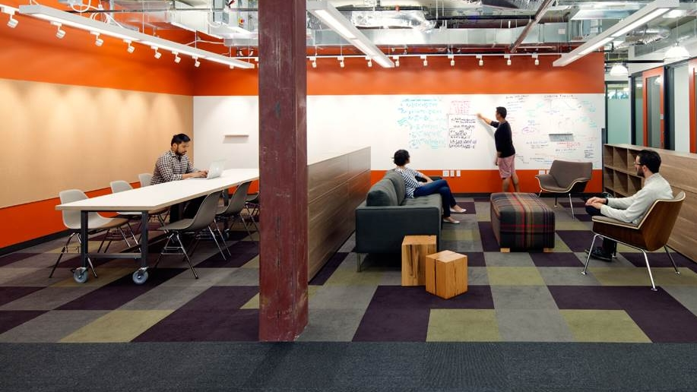

Continue Your Learning
@
www.microsoftvirtualacademy.com

Slide 31


Follow us online
Microsoft Developer

